Slide 1
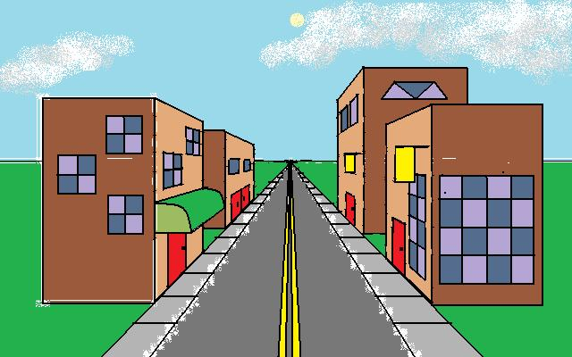
One Point Perspective: City Drawing A Tutorial

Slide 2
When completing this tutorial, you must use the following items:
* White, unlined paper
* A ruler or other straight-edge
* A pencil
You must complete all activities listed in the order they are listed in order to receive full credit for this tutorial.

Slide 3
Begin by setting up your paper for a one-point perspective drawing. Draw a horizon line and a vanishing point.

Slide 4
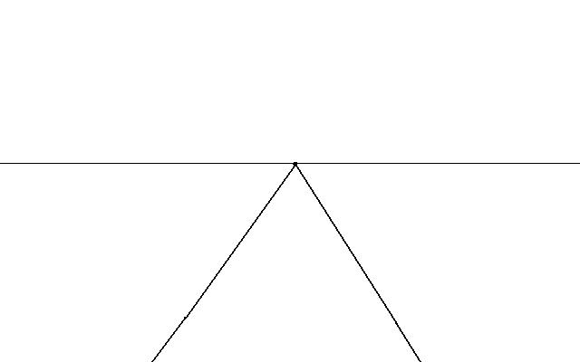
Draw two diagonal lines that lead from the vanishing point to the bottom of your paper. This upside down “V” will be your street.

Slide 5
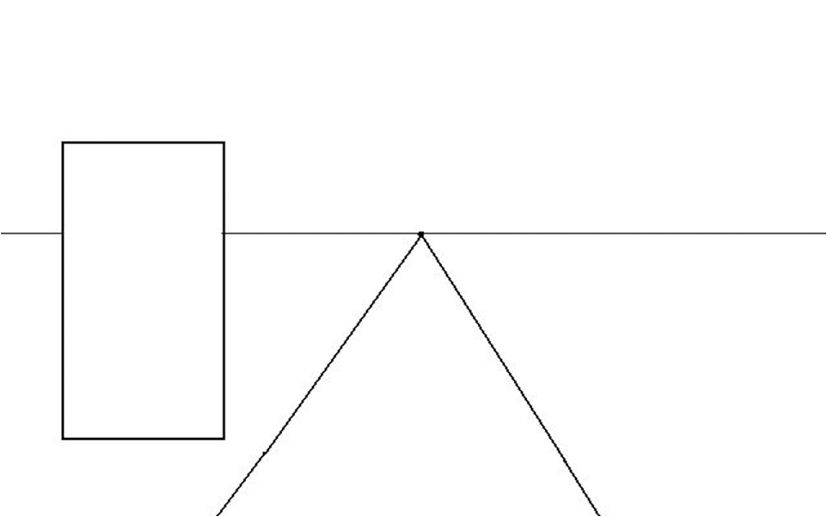
Draw a rectangle on the left side of the street. This will be your first building. Remember to keep your lines straight. Notice that the top of the rectangle is above the horizon line, and the bottom is below it.

Slide 6
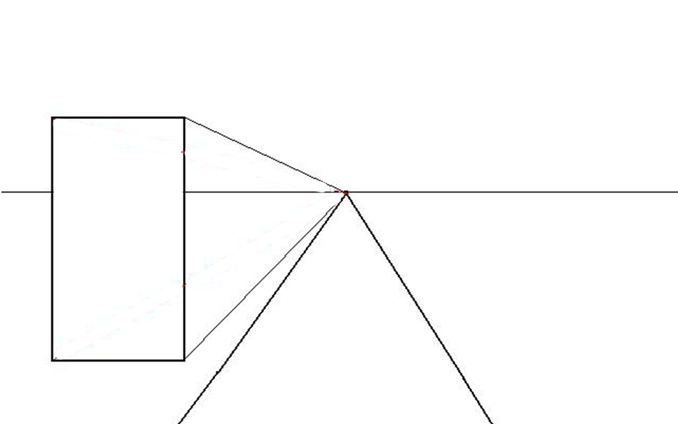
Draw a line between the vanishing point and each corner of the building.

Slide 7
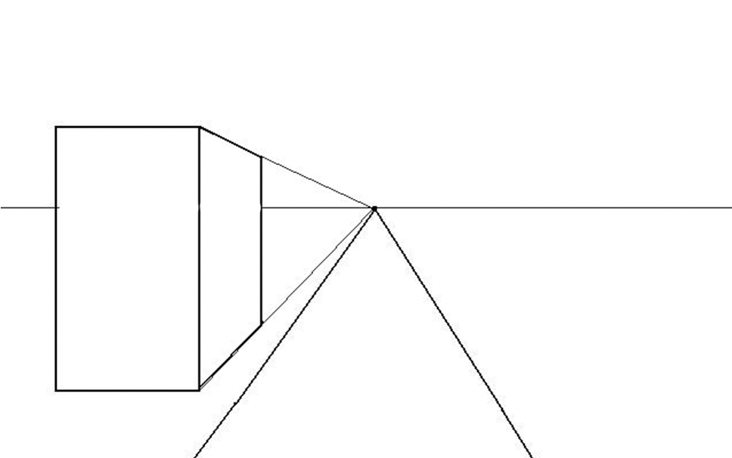
Draw a straight vertical line that starts at the top diagonal line and ends at the bottom one to end the side of your building. The bottoms of your building should be ended with diagonals that follow these diagonal lines.

Slide 8
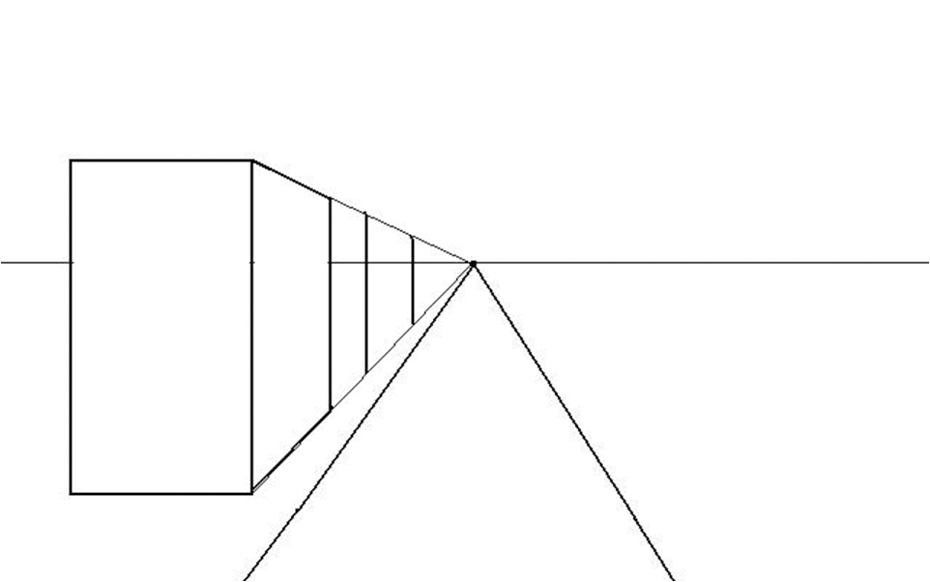
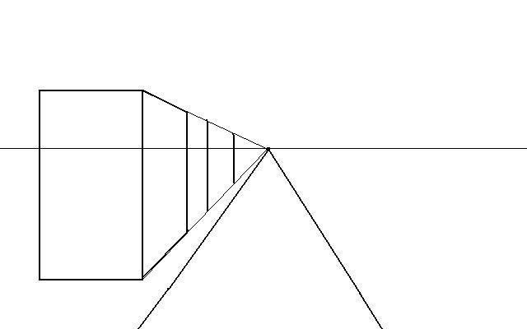
To add a second building of the same height to the left side of the street, draw a pair of vertical lines between the two diagonal lines you used to draw the first building.

Slide 9
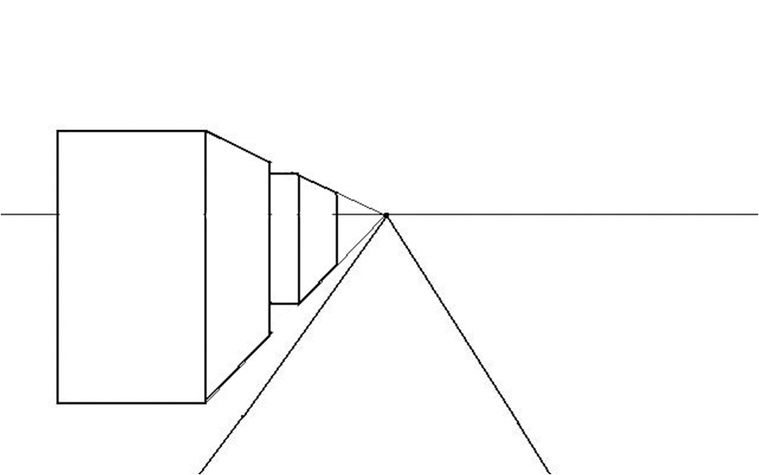
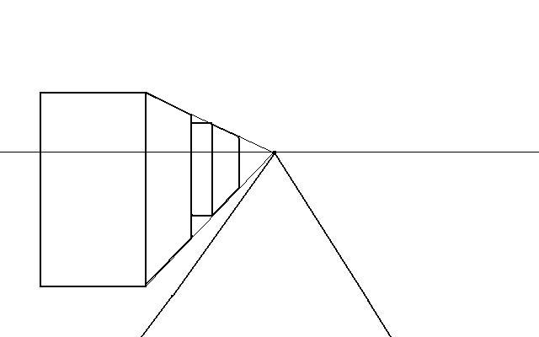
Add a front side to your building by drawing straight horizontal lines at the top and bottom.

Slide 10
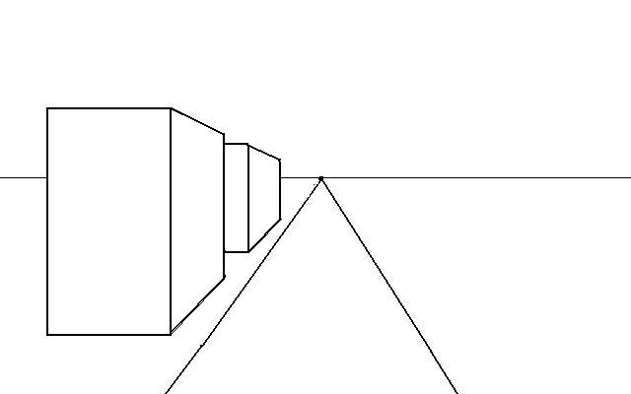
Erase the diagonal lines and the horizon line that is inside of the buildings you just drew.

Slide 11
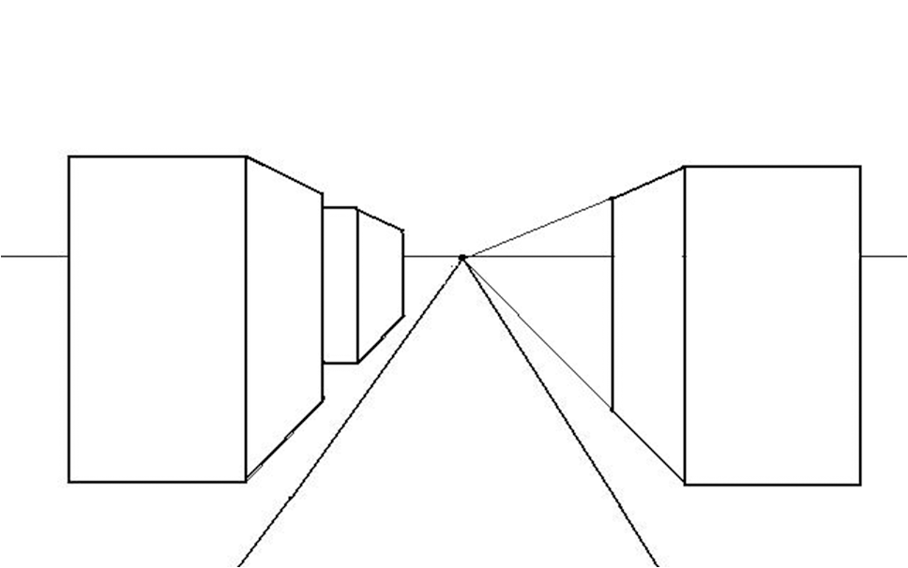
Draw a building on the right side of the street following the same directions. You can review the previous slides if need be.

Slide 12
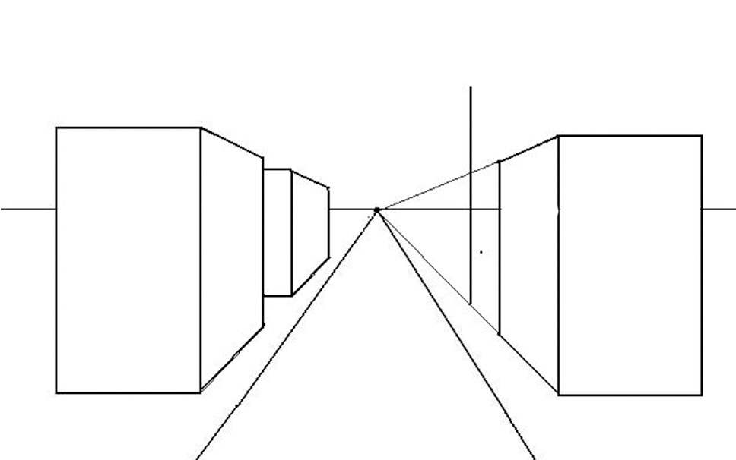
To create a building that is larger behind the building you just drew, draw a vertical line that begins on the same bottom diagonal line but extends above the top diagonal line.

Slide 13
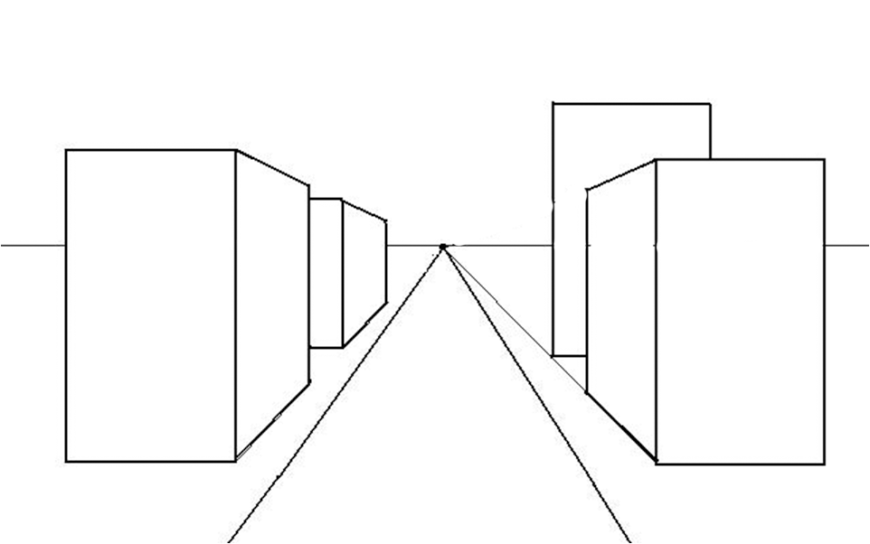
Draw two horizontal lines and a vertical line to finish out the rectangle for the front of the building. You will not see or draw the entire rectangle because it is overlapped by the building in front of it.

Slide 14
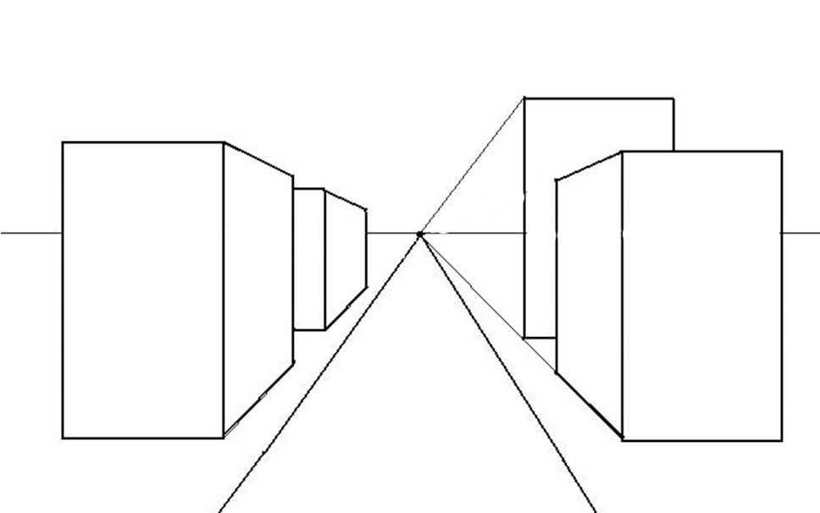
Draw an diagonal line between the vanishing point and the top corner of the newest building.

Slide 15
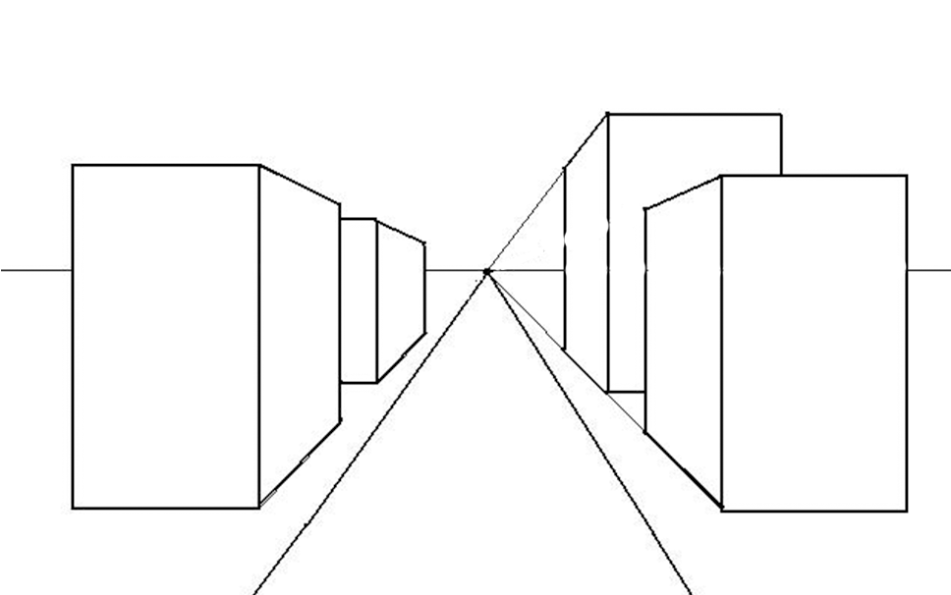
Draw a vertical line that starts at the top diagonal line and ends at the bottom one. The diagonal top and bottom diagonal line lines will be the slant of the side of the building.

Slide 16
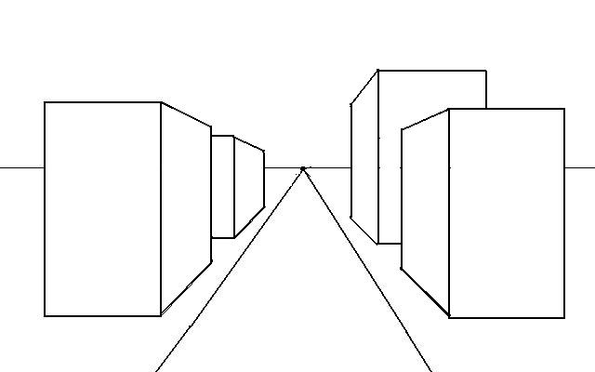
Erase the diagonal lines and the horizon line that is within the buildings on the right side of the street.

Slide 17
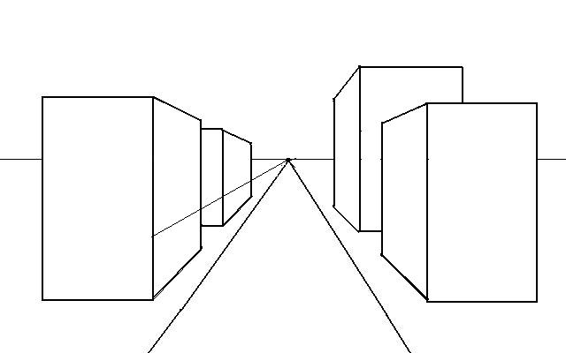
Add doors to your buildings on the left side of the street by drawing an diagonal line that cuts across the face of your building at whatever height you would like your doors to be.

Slide 18
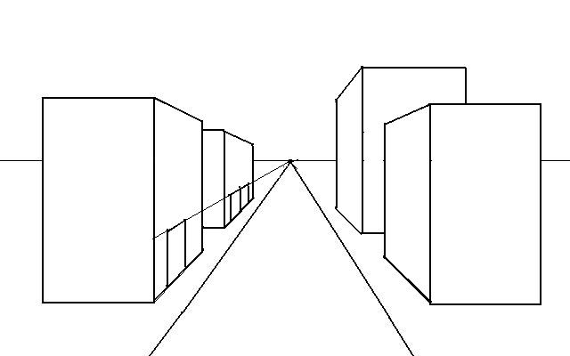
Draw vertical lines that start at the diagonal line you drew for the top of your door and end at the bottom of your building. Make sure that your lines are straight. The top diagonal line is the slant that the top of the door will be.

Slide 19
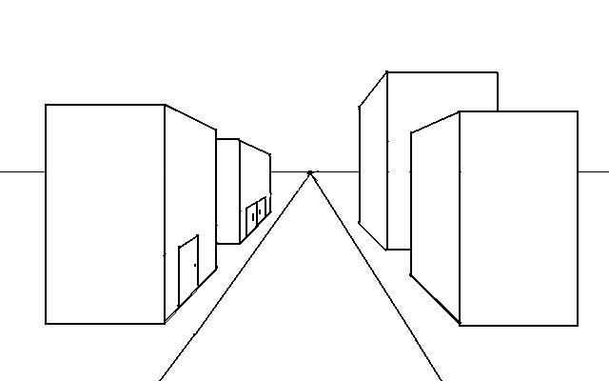
Erase your diagonal lines.

Slide 20
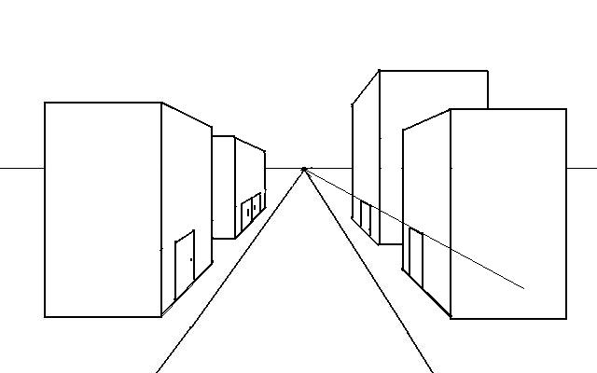
Create doors on the right side of the street.

Slide 21
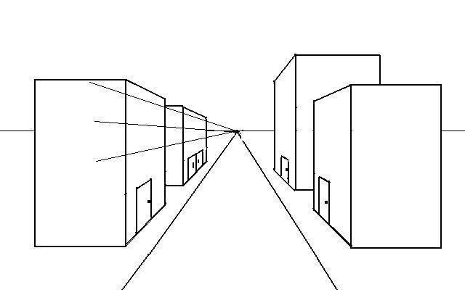
Draw diagonal lines that will define the tops and bottoms of the windows on buildings on the left side of the street.

Slide 22
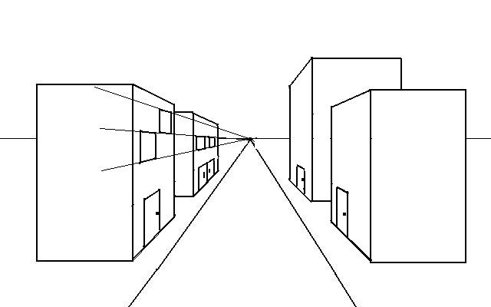
Draw vertical lines to separate the windows from the face of the building. The diagonal lines define the top and bottom slant of the windows.

Slide 23
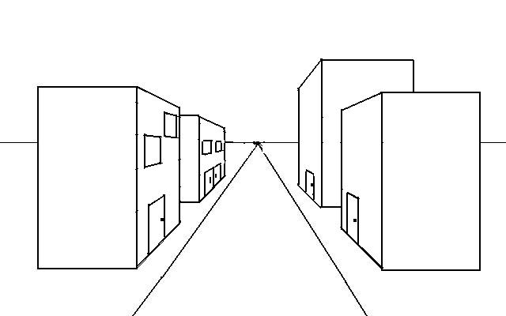
Erase the diagonal lines.

Slide 24
Add panes to your windows by drawing orthagonals that lead from the vanishing point through the center of your windows.

Slide 25
Erase the diagonal lines that are outside of the windows, then add vertical lines to the centers. Be sure that these lines are straight.

Slide 26
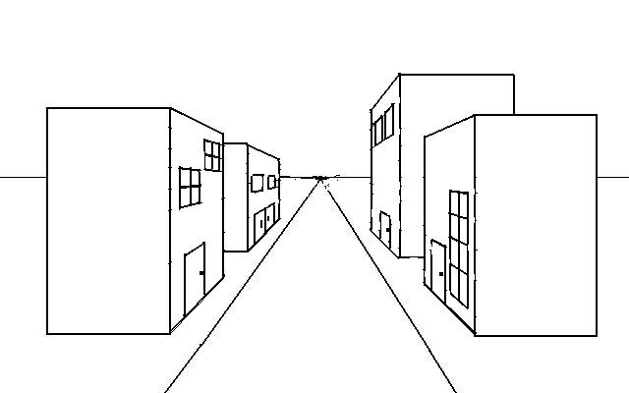
Draw windows on the buildings on the right side of the street.

Slide 27
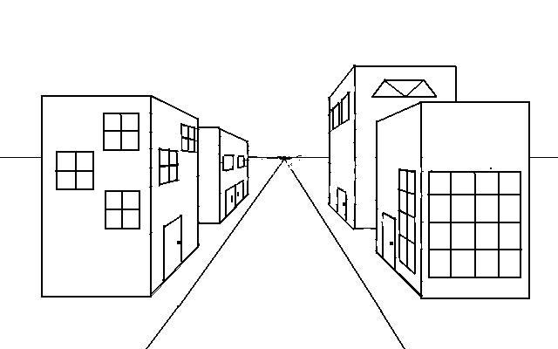
Add doors and windows to the sides of the building that is facing you. Remember that the vanishing point does not come into play when you are adding features to that side of the building.

Slide 28
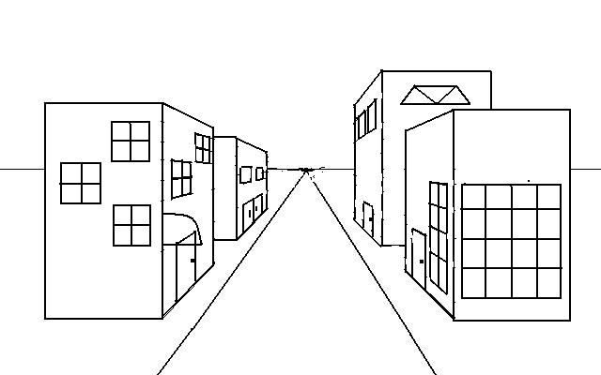
Add an awning by drawing it from the side against your front left building. This shape will have a straight horizontal bottom and a curved top.

Slide 29
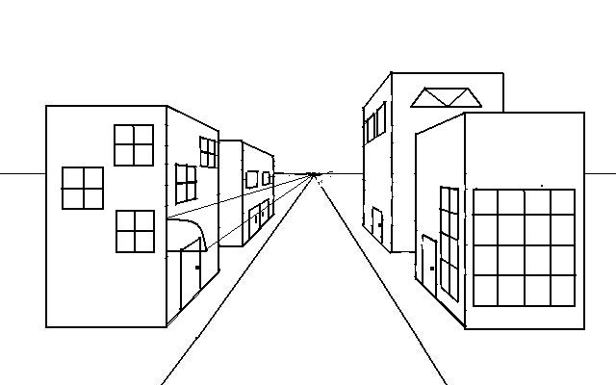
Match the top of the awning with the vanishing point to draw the top diagonal line, then match the bottom front corner to the vanishing point and draw a second diagonal line.

Slide 30
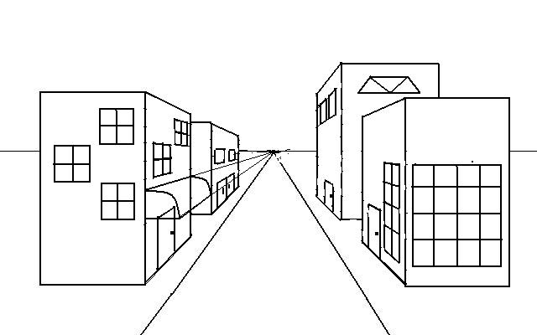
Draw the back side of the awning. Start at the point where the diagonal line intersects the back wall of the building. Repeat the same curve that the front of the awning has.

Slide 31
Erase all of the diagonal lines and the lines from the building that are inside of the awning.

Slide 32
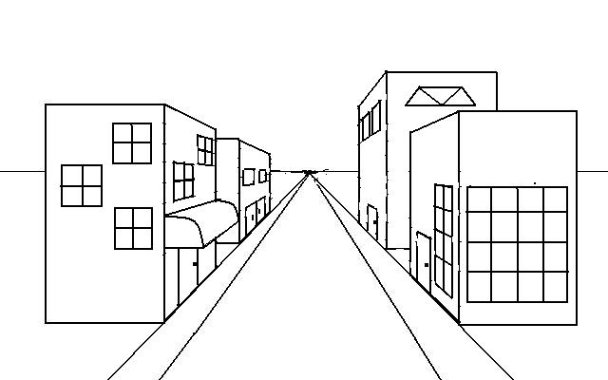
Draw lines leading from the vanishing point beside the street to make the sidewalk.

Slide 33
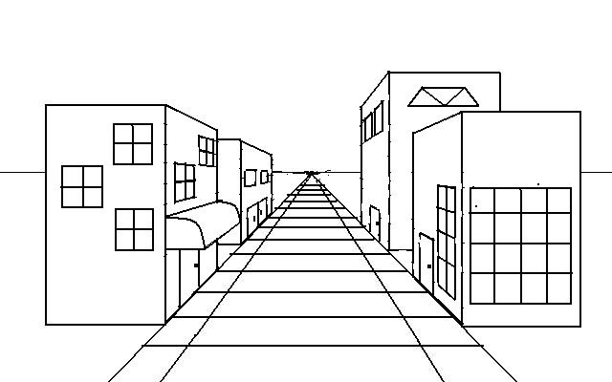
Draw horizontal lines across the street to mark out sidewalk pavers, making sure to have the lines get closer together as they recede further into the distance.

Slide 34
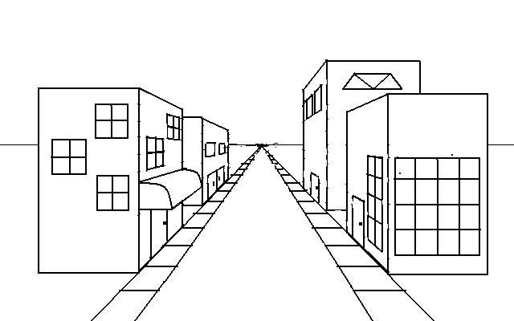
Erase all of the lines between the sidewalks to just leave the pavers. Double check to be sure that your lines are straight horizontals.

Slide 35
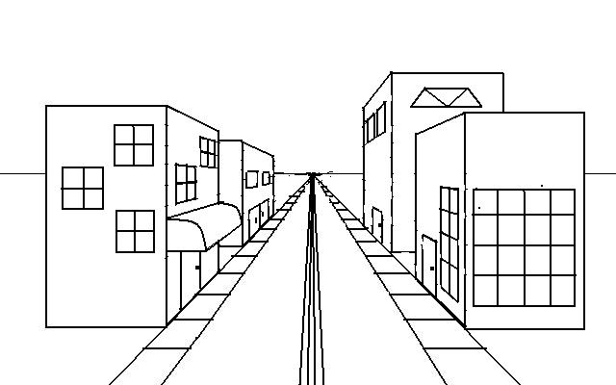
Add lines to the road by drawing diagonal lines leading back to the vanishing point.

