Slide 1
Digging Deeper
~ Artist Steal ~

Slide 2
Artist Steal
For this section you are going to digger deeper to discover how artists have stolen to create art. You will seek out artist who have used other works to create art sometimes by mistake and sometimes on purpose.
There are three parts to this section: Part A, B and C

Slide 3
Part A: Artist Steal
Choose one of the following videos and reflect on what you learn by writing a short paragraph in your sketchbook.

Slide 4
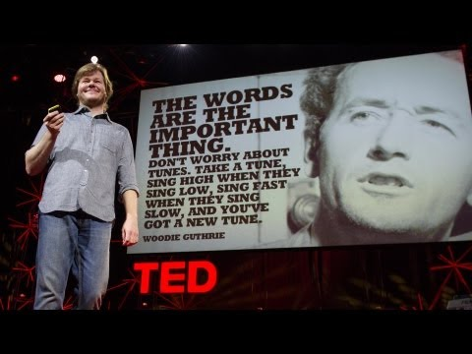
Part A: Artists Steal
Choice One:
Watch the video
Kirby Ferguson: Embrace the remix
http://on.ted.com/FergusonRemix
Reflect on what you learn by writing a short paragraph in your sketchbook.

Slide 5
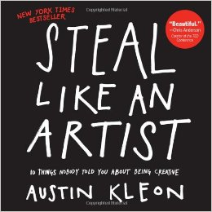
Part A: Artists Steal
Choice Two:
Watch Steal Like An Artist:
Austin Kleon at TEDxKC
http://youtu.be/oww7oB9rjgw
Reflect on what you learn by writing a
short paragraph in your sketchbook.

Slide 6
Part B: Artists Steal
Explore the definition of the words
Appropriation, Parody, and Intertextuality.
What are the differences? How are they similar?
Create your own definition for each word and write those in your sketchbook.

Slide 7
Part C: Artists Steal
Choose one of the following methods for collecting your inspiration.

Slide 8
Part C: Artists Steal
Choice One:
Create a Pinterest board of artworks that use parody, appropriation or intertextuality in some way. You can pin as many as you want but should try to find at least 20.
Never created a Pinterest board before?
Start by clicking here!

Slide 9
Part C: Artists Steal
Choice Two:
Create a blog post of artworks that use parody, appropriation or intertextuality in some way. With each image, write about short summary of the work. Blog about at least 15.
Don’t have a blog yet?
Learn how to create a Weebly page by
clicking here!

Slide 10
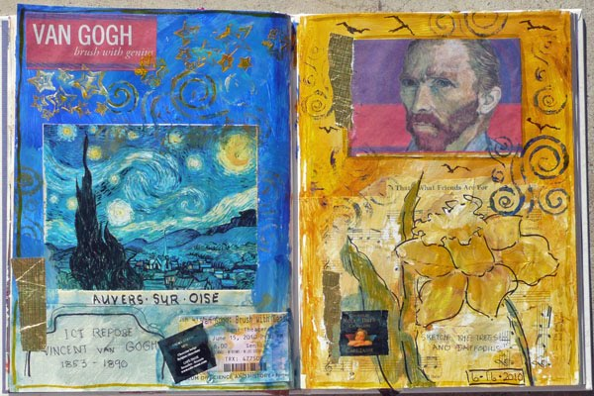
Part C: Artists Steal
Choice Three:
Search the internet for artworks that use parody, appropriation or intertextuality in some way. Print these out and create a visual journal page in your sketchbook. How you design the page is up to you. Try to include at least 15 works.
check out how other people have created visual journal pages on the Apex Pinterest board…
Click here!

Slide 11
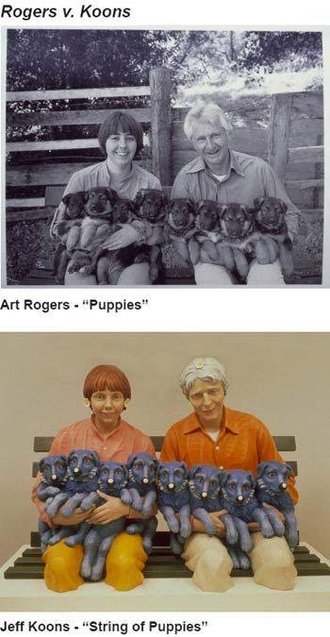
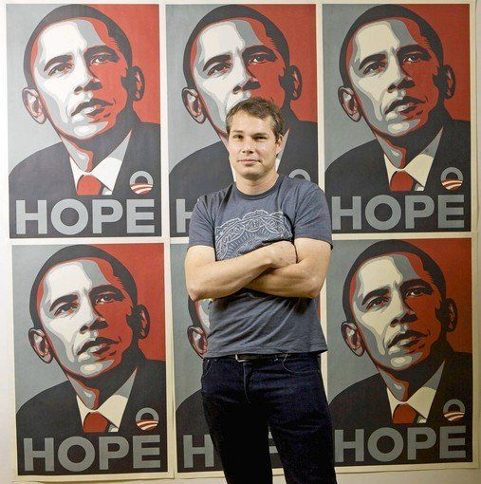
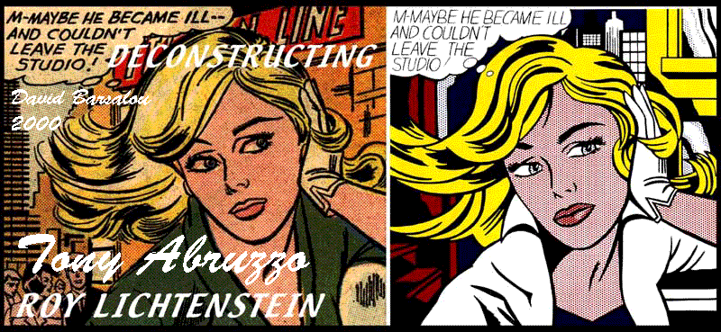
Part C: Artists Steal
Getting started:
To get started, here is a list of artists who use text that you might consider searching.
Shepard Fairey, Roy Lichtenstein, Jeff Koons, Damien Hirst

Slide 12
Once you have completed Digging Deeper you will move on to the next section:
Section Three - Challenges!

